Slide 1
C++ Unit test
https://learn.microsoft.com/en-us/visualstudio/test/how-to-use-microsoft-test-framework-for-cpp?view=vs-2022

Slide 2
Visual Studio Unit test

Slide 3
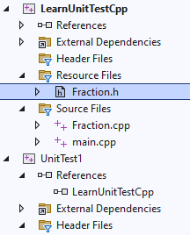
Preparation
Write unit test for class Fraction
First - Create a project named LearnUnitTestCpp
Add Fraction.h and Fraction.cpp
Add UnitTest Project named UnitTest1

Slide 4
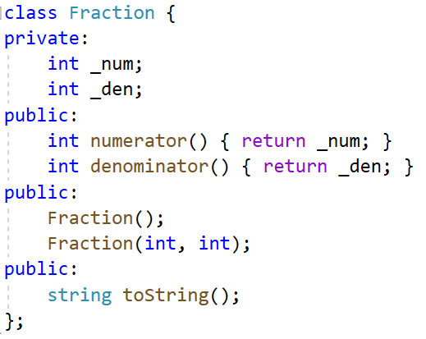
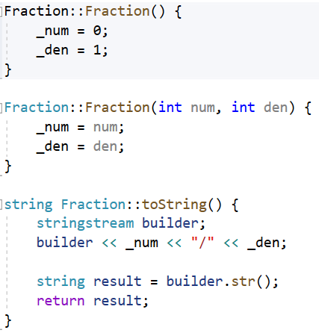
Source code for Fraction class

Slide 5
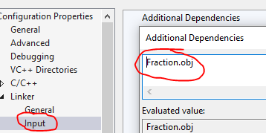
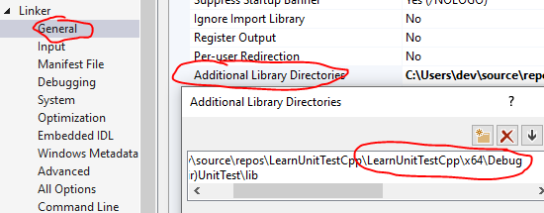
Add .h and .obj reference for UnitTest1 project
Configuration Properties > Linker > Input page, then select Additional Dependencies.
Edit, add .obj files. (Don't use full path)
Configuration Properties > Linker > General page, then select Additional Library Directories.
Edit, add full path folder

Slide 6
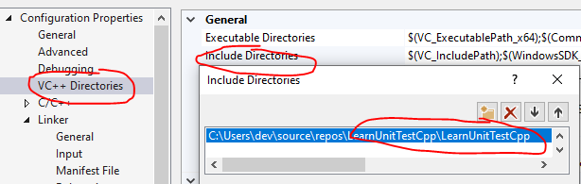
Add .h include folder
Select the Configuration Properties > VC++ Directories page, then select Include Directories.

Slide 7
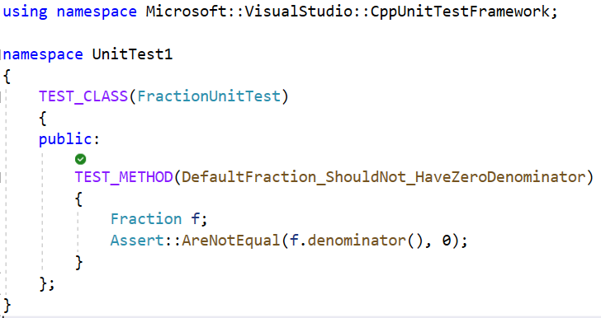
Write our first unit test

Slide 8
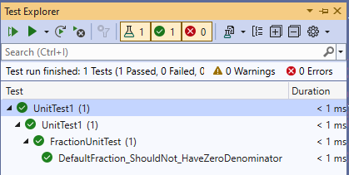
Explorer the result

Slide 9
Unit test naming convention
https://medium.com/@stefanovskyi/unit-test-naming-conventions-dd9208eadbea
Test name should express a specific requirement
Test name could include the expected input or state and the expected result for that input or state
Test name should be presented as a statement or fact of life that expresses workflows and outputs
Test name could include the name of the tested method or class

Slide 10
Personal recommendation
<Method>_Should<expected>_When<Condition>
Examples
FractionDenominator_ShouldNotBeZero_WhenCreateDefaultFraction
Balance_ShouldIncrease_WhenDepositPositiveValue
Balance_ShouldDecrease_WhenWithdrawaIsMade

Slide 11
Sample unit test for Fraction class
TEST_METHOD(DefaultFraction_ShouldNot_HaveZeroDenominator) {
Fraction f;
Assert::AreNotEqual(f.denominator(), 0);
}
TEST_METHOD(Fraction_Should_PrintStringValue) {
Fraction f(1, 2);
string result = f.toString();
string expected = "1/2";
Assert::AreEqual(result, expected);
}
TEST_METHOD(ParameterizedConstructor_ShouldThrowException_WhenDenominatorIsZero) {
Assert::ExpectException<std::exception>([]() {
Fraction(1, 0);
});
}

